Slide 1
Employee Data Analysis using Excel
STUDENT NAME:G.Aavithiya
REGISTER NO:312201592
DEPARTMENT:Commerce
COLLEGE:Prof.dhanapalan college of science and management

Slide 2
PROJECT TITLE
Employee Performance Analysis using Excel

Slide 3


AGENDA
Problem Statement
Project Overview
End Users
Our Solution and Proposition
Dataset Description
Modelling Approach
Results and Discussion
Conclusion
3/21/2024 Annual Review

Slide 4

PROBLEM STATEMENT
∆ Designing the system is to maintain data of employees
∆To make easy controlling of employees to divide jobs and access control between employees
∆To use technology for accurate and timely processing

Slide 5

PROJECT OVERVIEW
.
To review the 20 members of employee performance regarding PERFORMANCE RATING
Apply and reinforce your knowledge through practical exercises
Allow yourself sufficient time to experiment with diverse problem-solving approaches.
Seek valuable insights from others

Slide 6
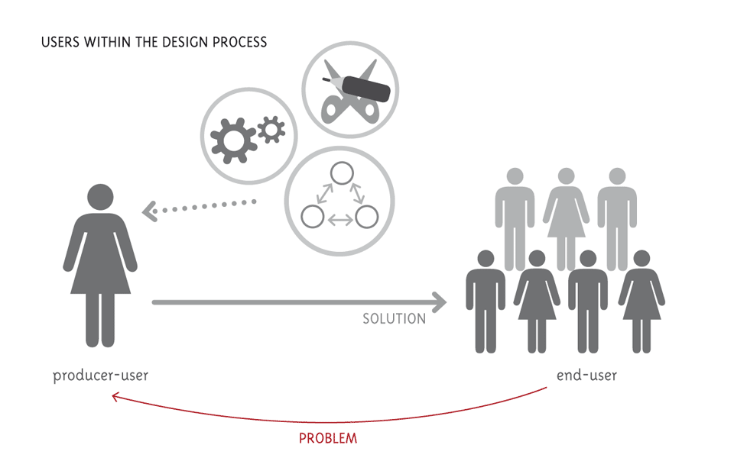

WHO ARE THE END USERS?
The term "end user" refers to the consumer of a good or service, often who has some innate know-how that is unique to consumers.

Slide 7

OUR SOLUTION AND ITS VALUE PROPOSITION
Conditional formatting –missing
filter remove
formula -performance
pivot -summary
graph –data visualization

Slide 8
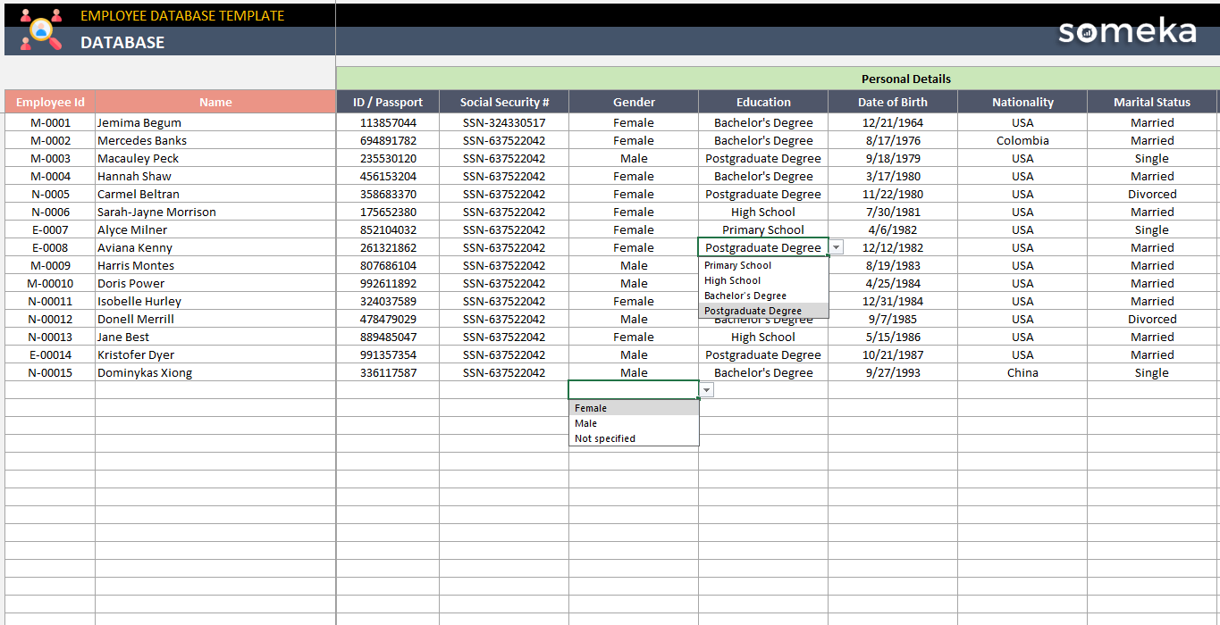
Dataset Description

Slide 9

THE "WOW" IN OUR SOLUTION
∆support sustainability
∆Human connection
∆Provide great customer support
∆Using social media
3/21/2024 Annual Review
9

Slide 10
MODELLING
~collect data and observe
~Back up your findings
~stay curious
~provide a possible solution
~ clearly outline the problem
~Give context
10

Slide 11
RESULTS
∆Give feedback
∆Recognise your team work
∆Offer a flexible teamwork
∆Good communication
11

Slide 12
conclusion
Gather data and observe
Keep asking and check in on the progress)
Growth mindset
covered the root cause of the problem

